Slide 1
3-Bit One-Hot Up Counter
A one-hot counter creates an output in which one and only one bit is asserted at a time.
In an up counter configuration, the assertion is made on the least significant bit first, followed by the next higher significant bit, and so on (i.e., 001, 010, 100, 001…).
A one-hot counter can be created using state-encoded outputs. For a n-bit counter, the machine will require n D-Flip-Flops.

Slide 2
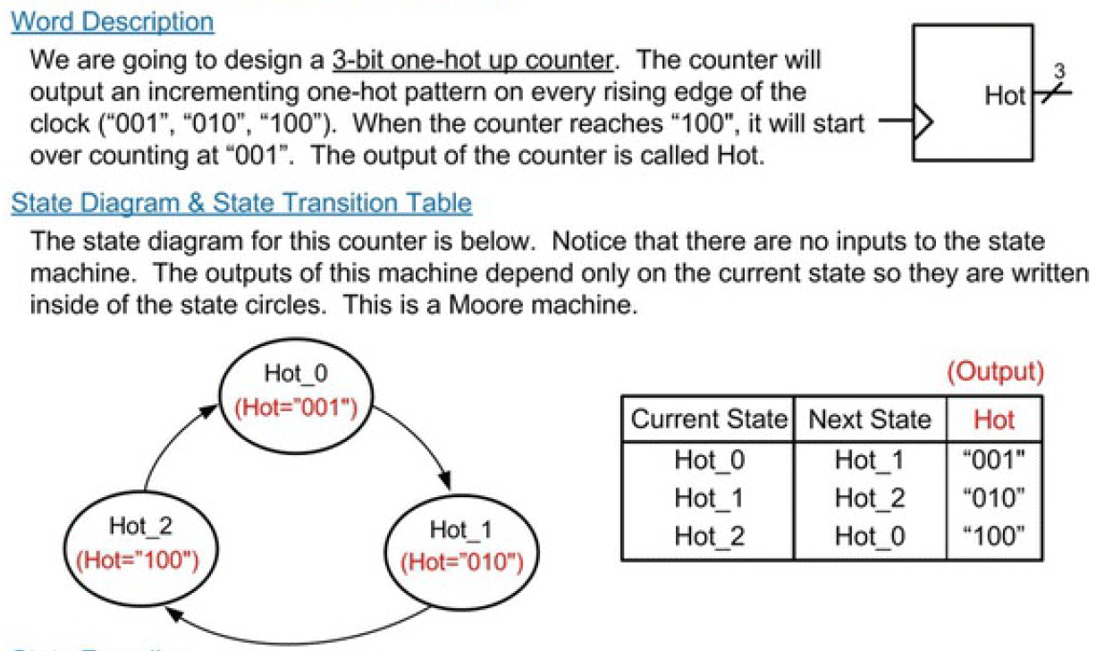

Slide 3
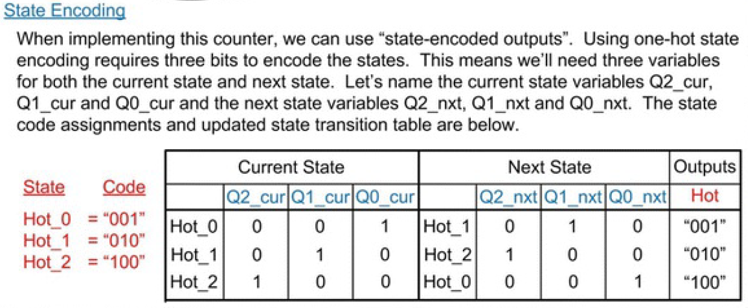

Slide 4
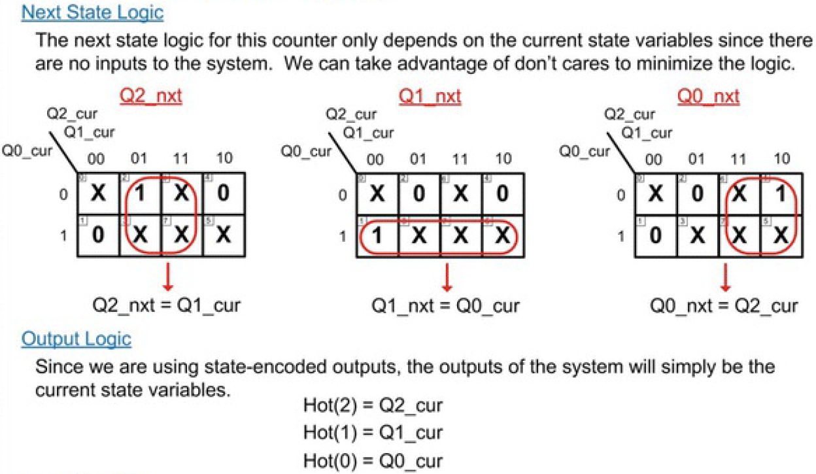

Slide 5
